Slide 1
Packing puzzle problem
with reinforcement learning
Martin van der Schelling and Alex Xiaole Jiang

Slide 2
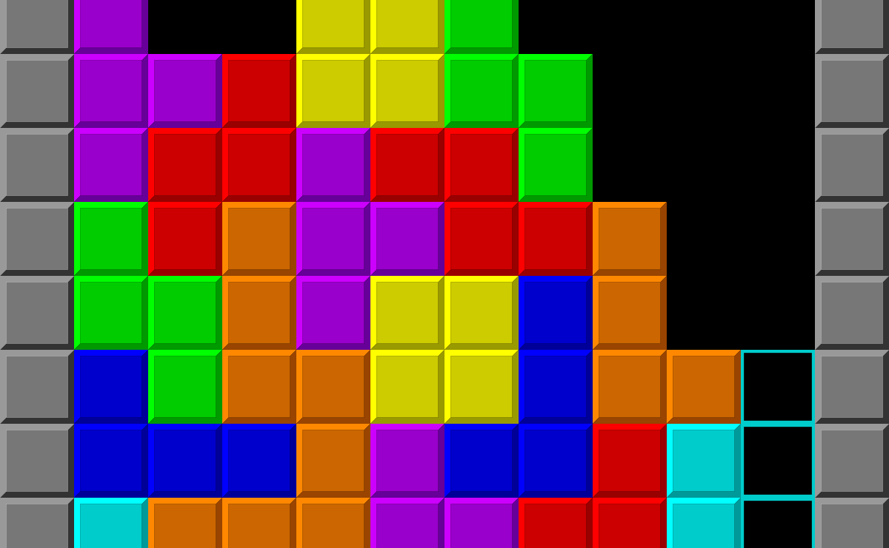
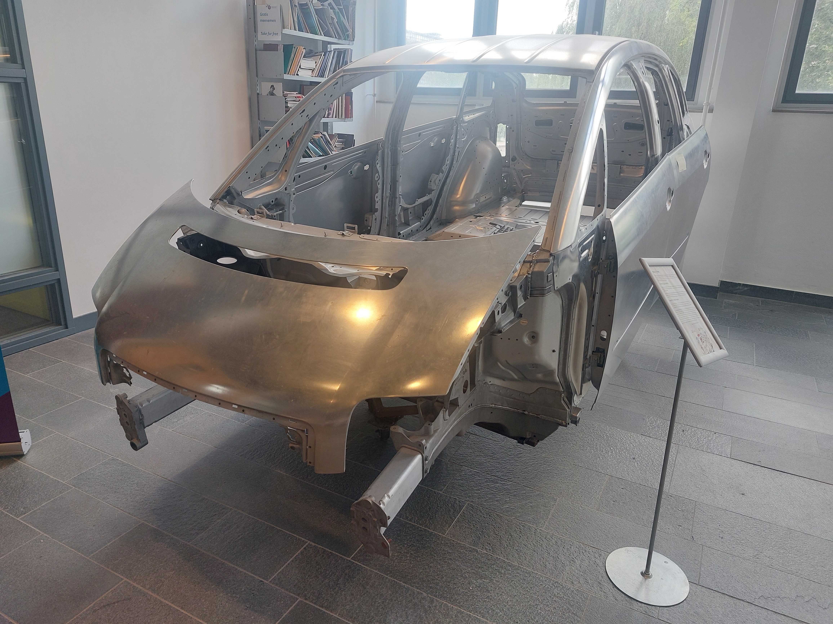
Motivation
Modern applications need materials and structures with complex shapes and properties
Reuse existing structures

Slide 3
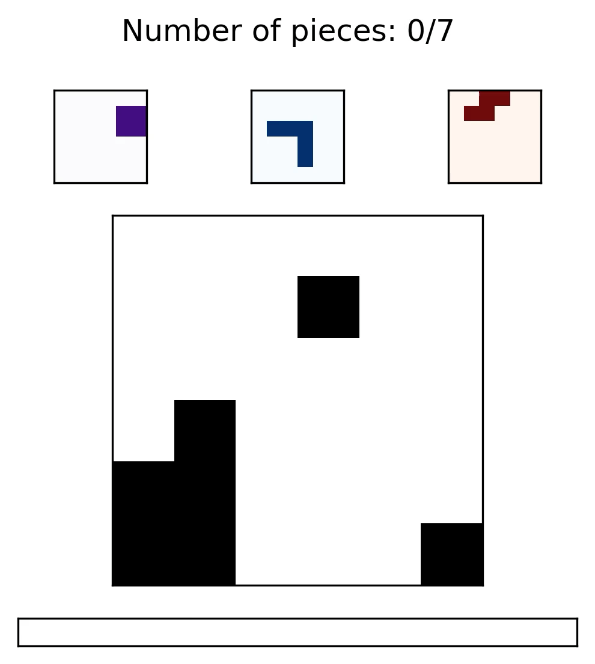
The Setup
Observation
Current grid (n, n)
Next piece (n, n)
Remaining pieces (p – t, n, n)
Action
Translate the next piece horizontally and vertically
Reward
White pixel = -1,
Black pixel = 0
Block adds value 1 to the pixel
Out-of-bounds: +1
Reward proportional to minimizing the sum of absolute value of all pixels
N = grid_size
P = number of pieces
T = timestep

Slide 4
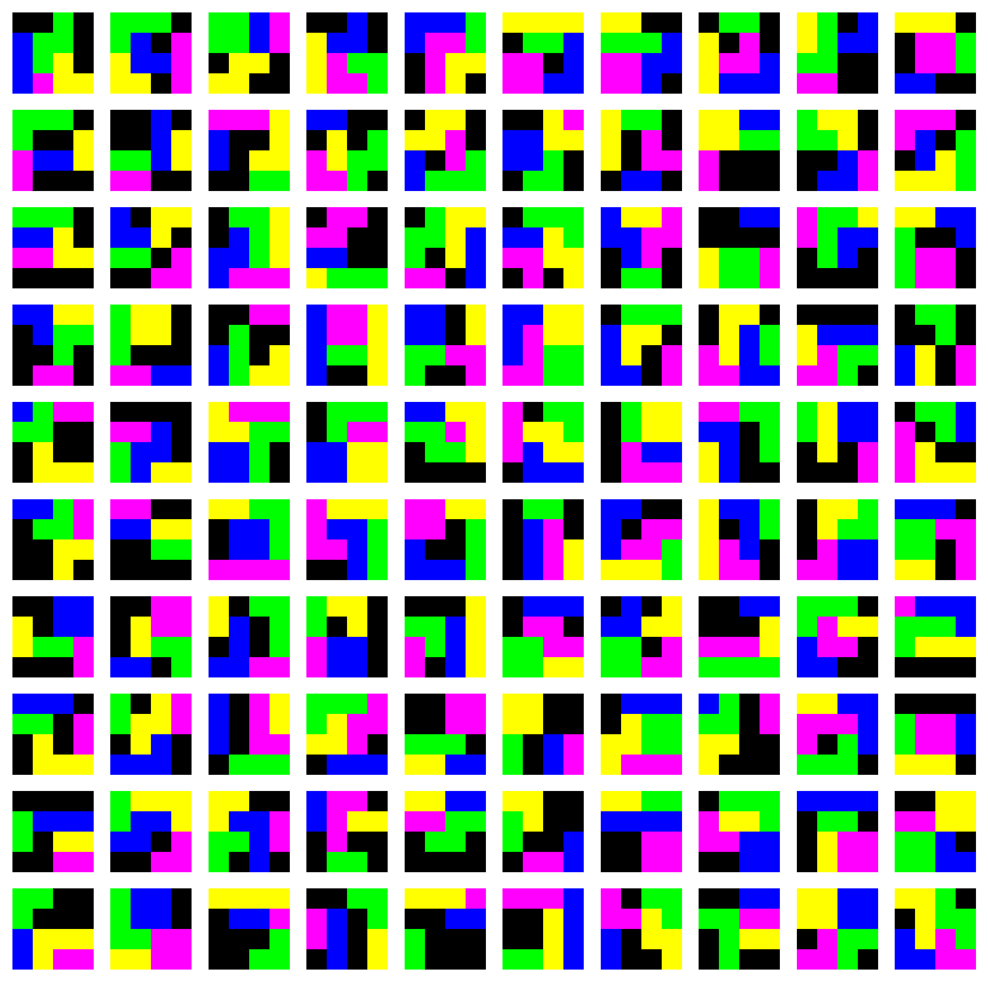
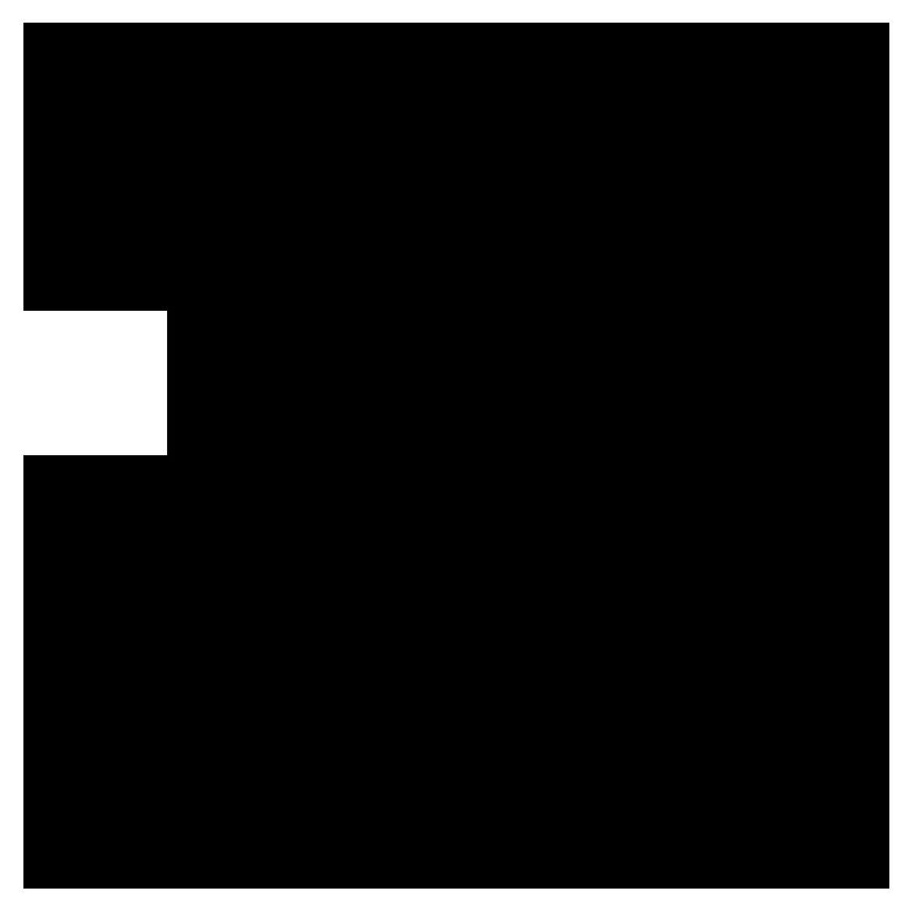
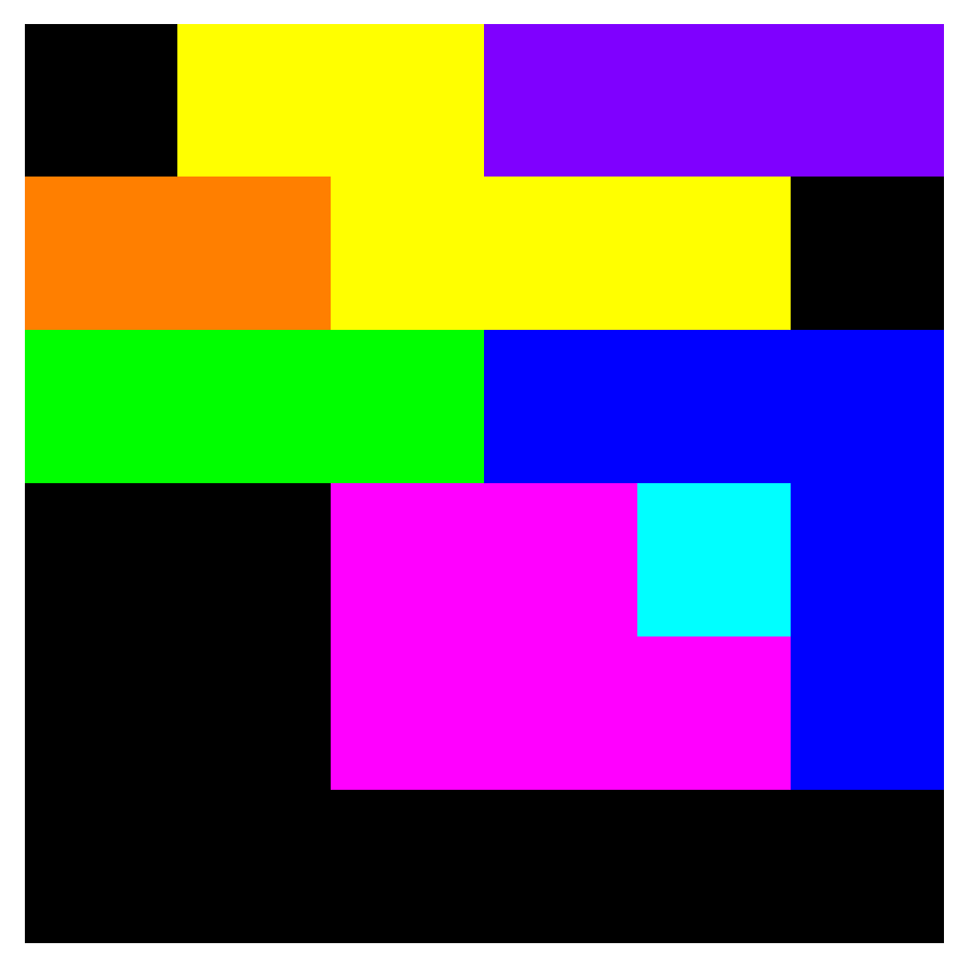
Generating puzzles
Set a grid_size
Choose the number of pieces and their minimum and maximum size

Slide 5
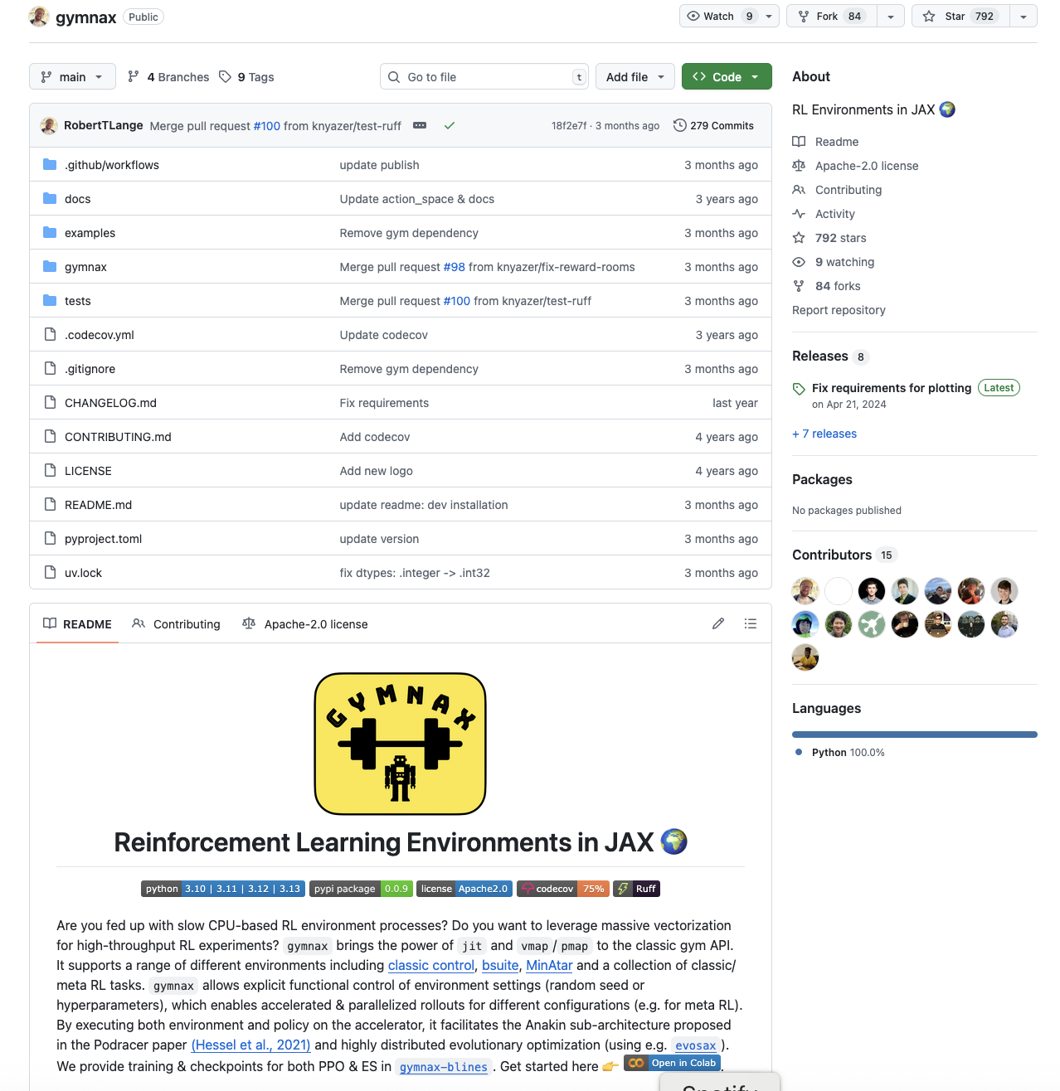
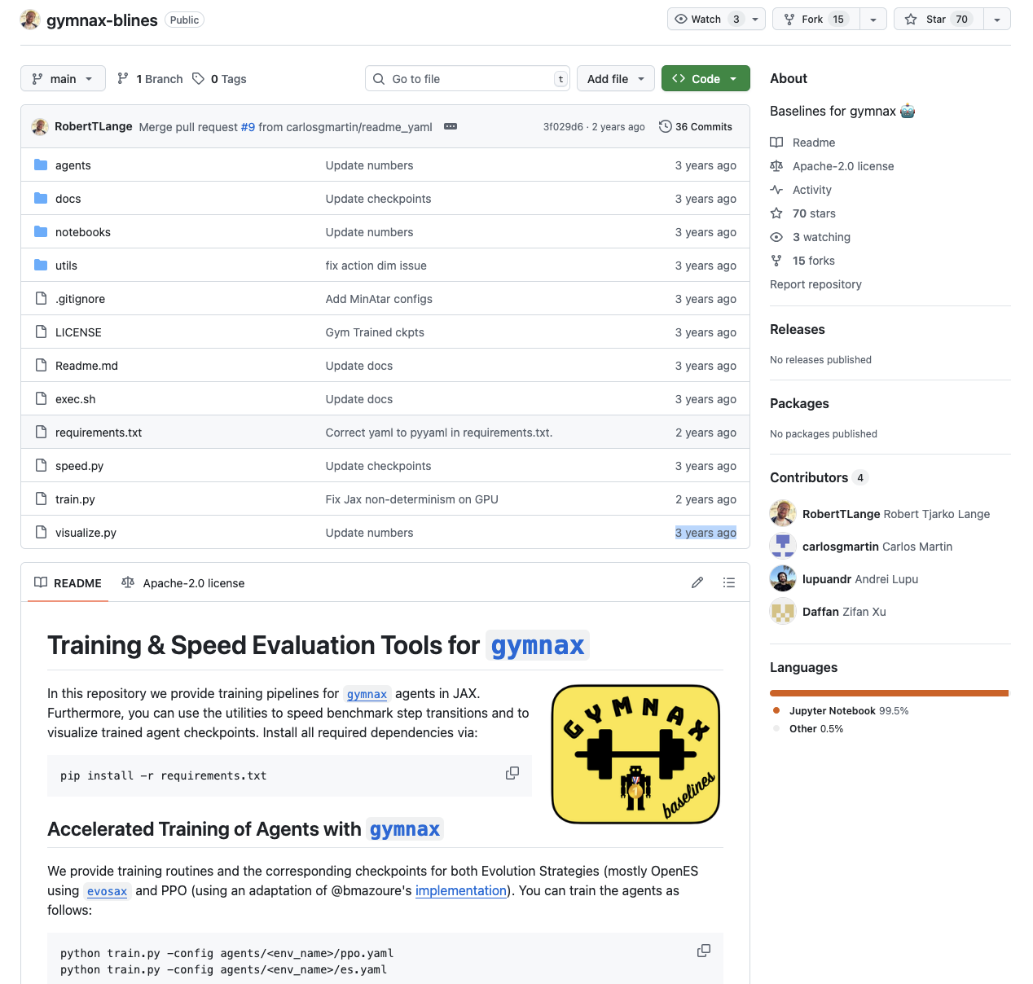
Implementation
PPO baseline
Policy model: 2 layer MLP with 64 hidden units
Adam optimizer
Warm-up where lr=5e-2
Entropy coeff: 0.01
Discount factor: 0.99
Critic coeff: 0.5
GAE lambda: 0.905
gymnax: Standardized OpenAI gym interface, implemented in jax
gymnax-blines: Base line algorithms, including PPO
gymnax
gymnax-blines

Slide 6
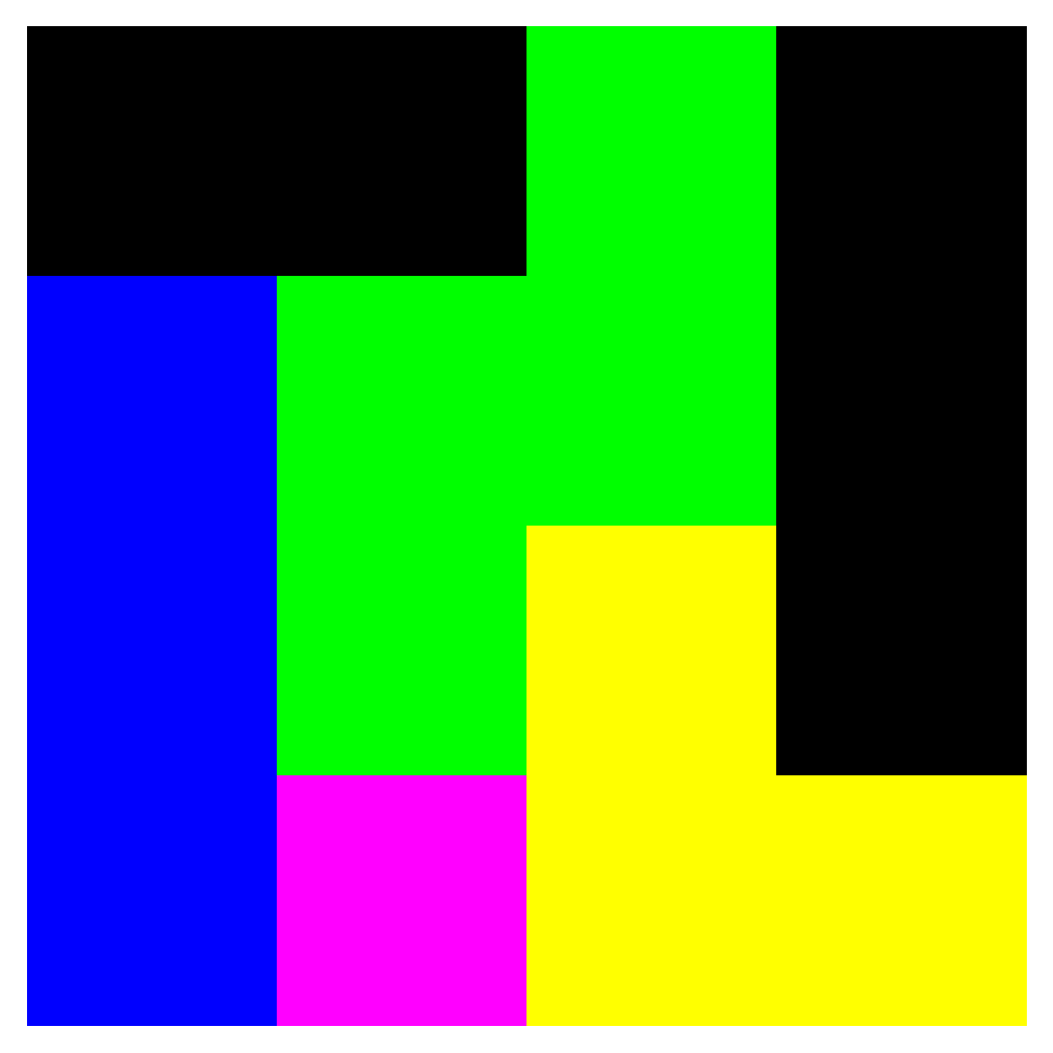
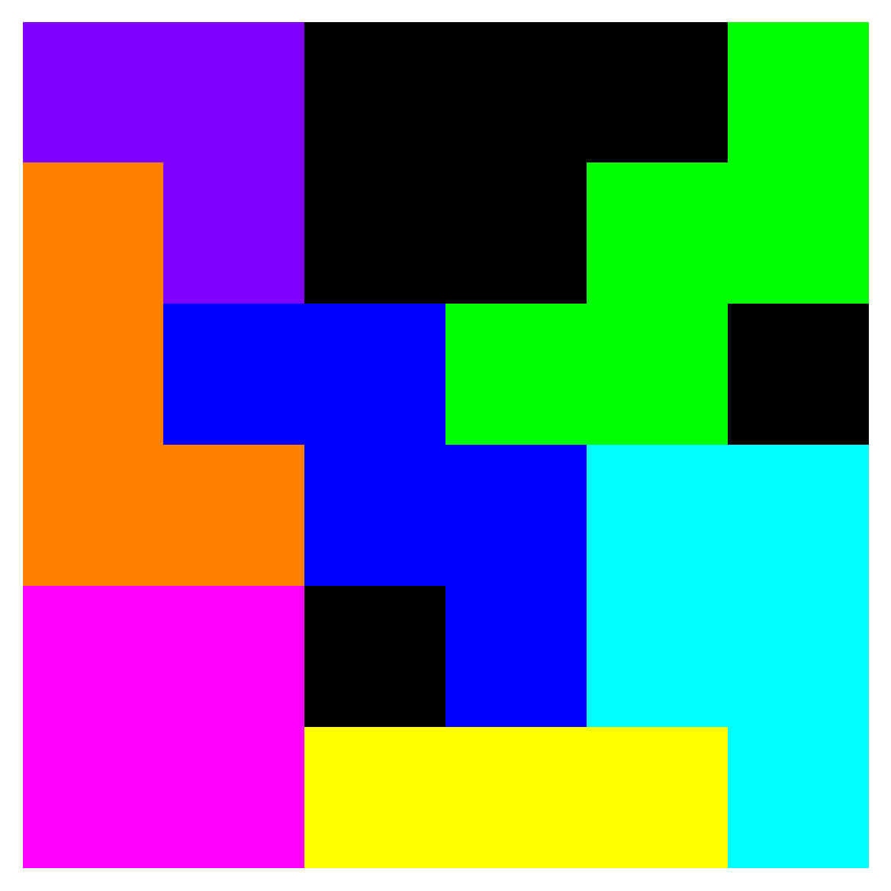
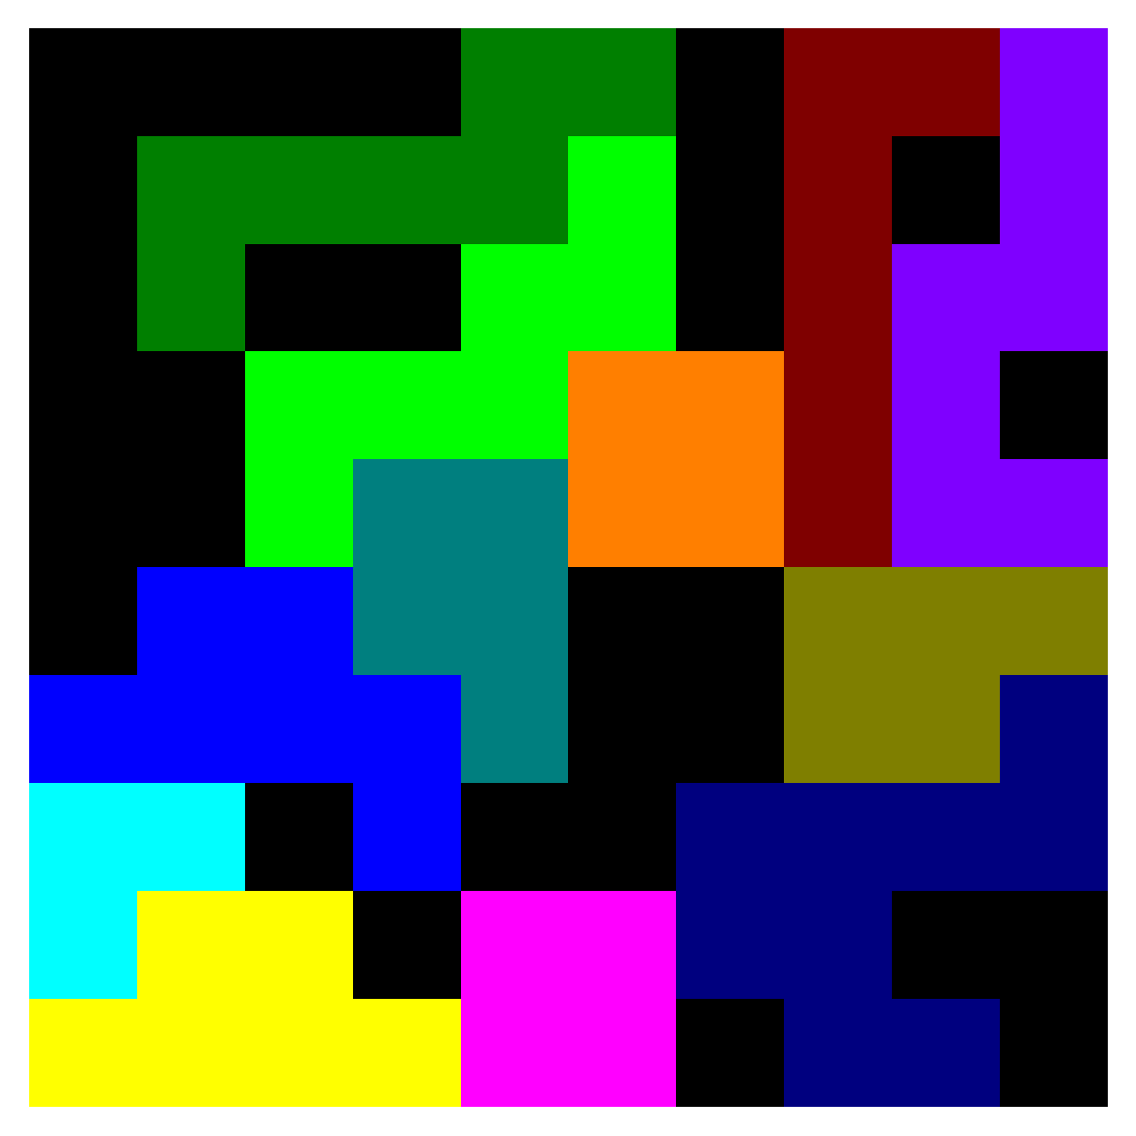
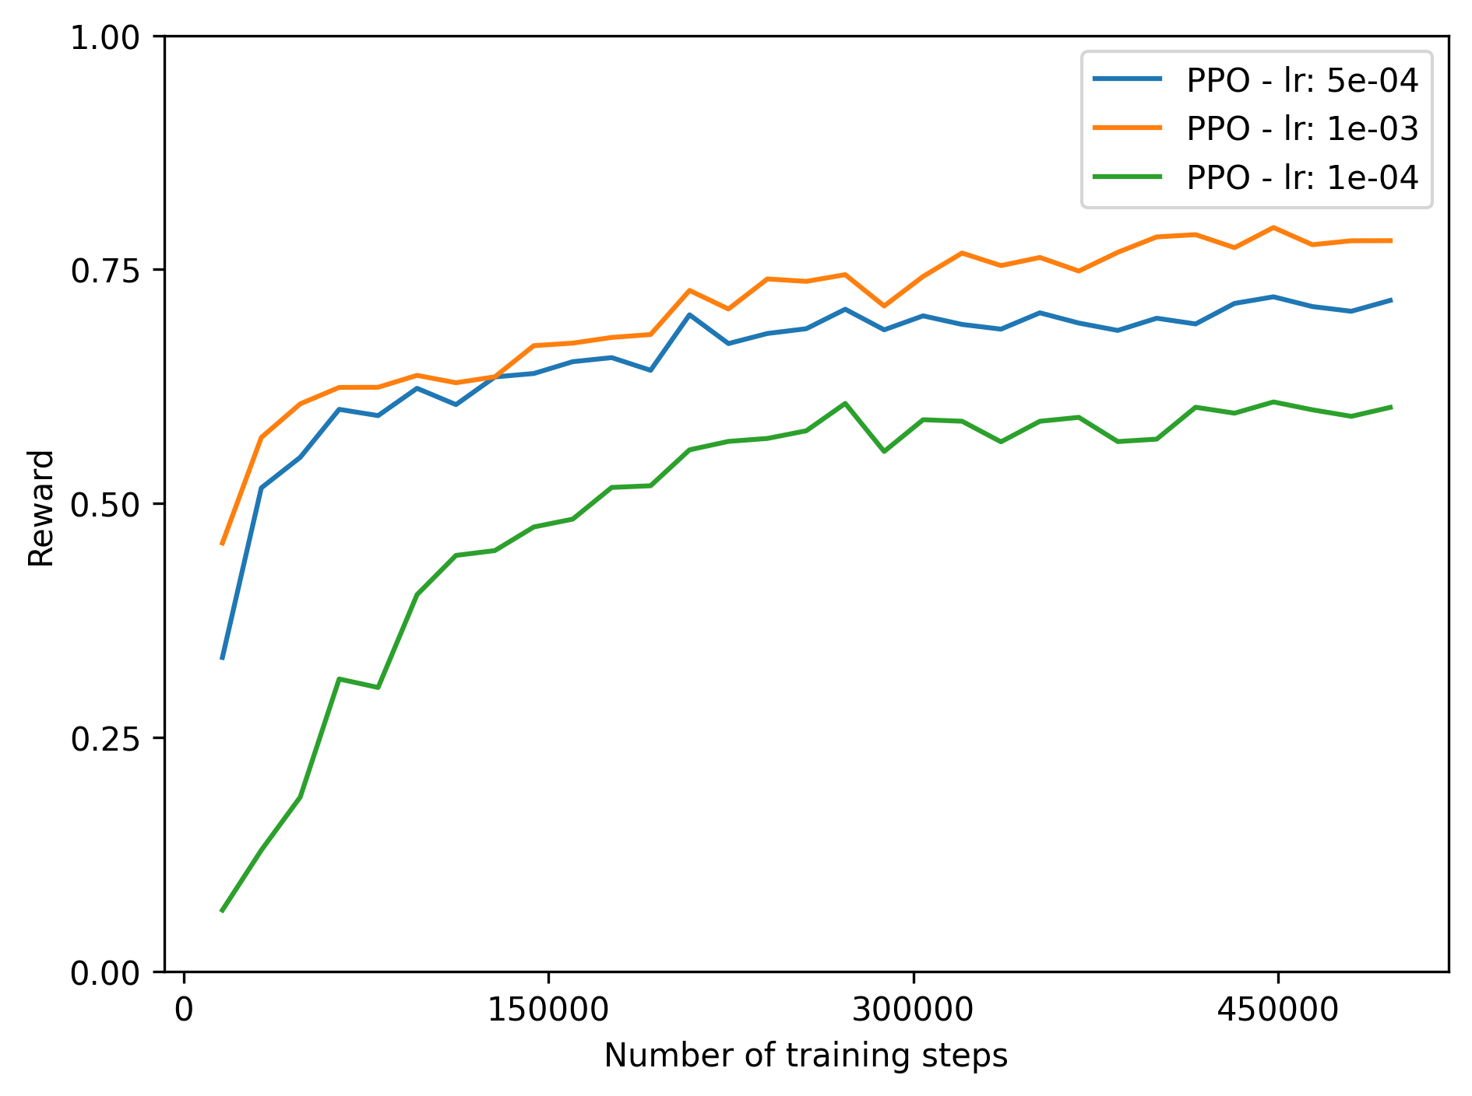
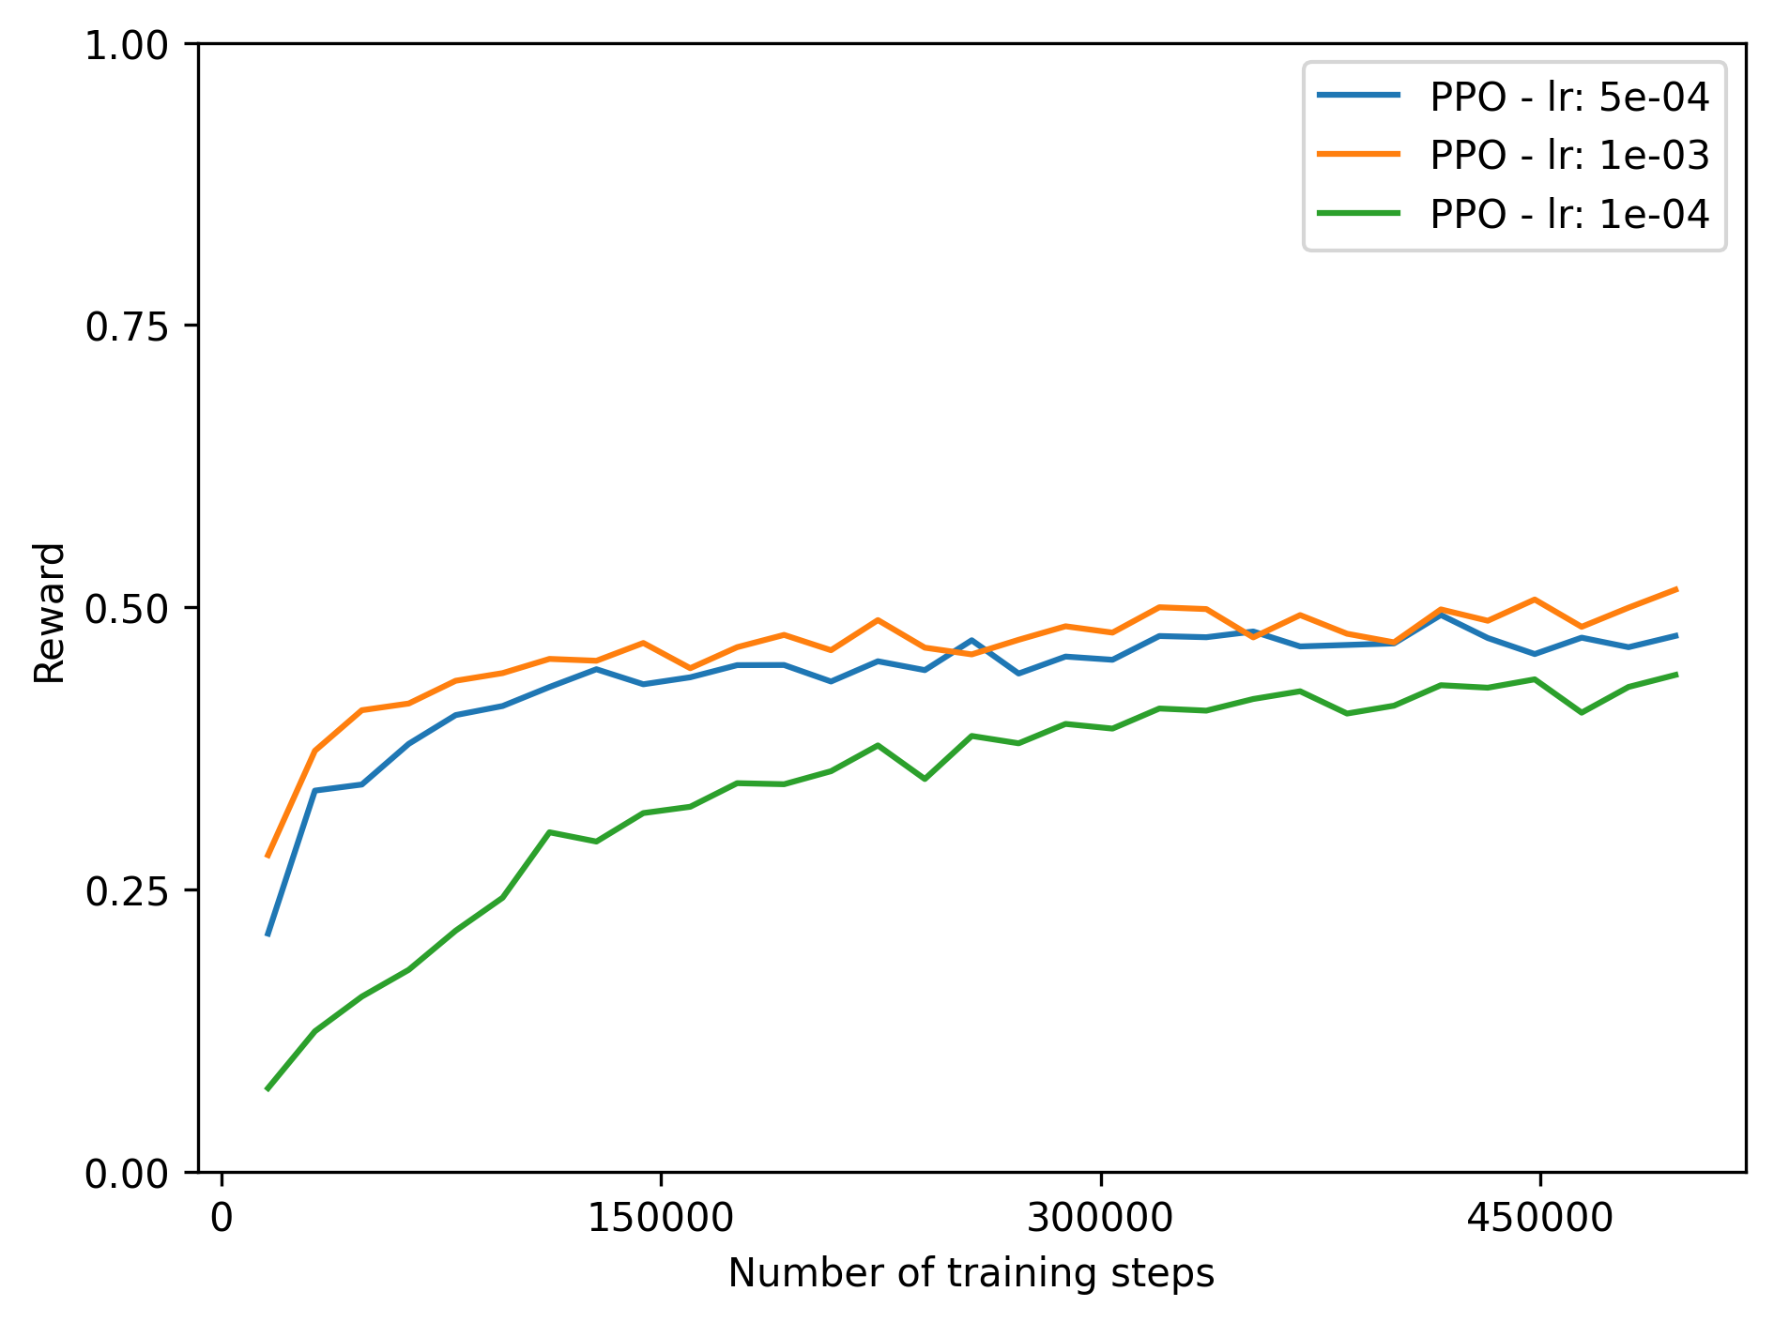
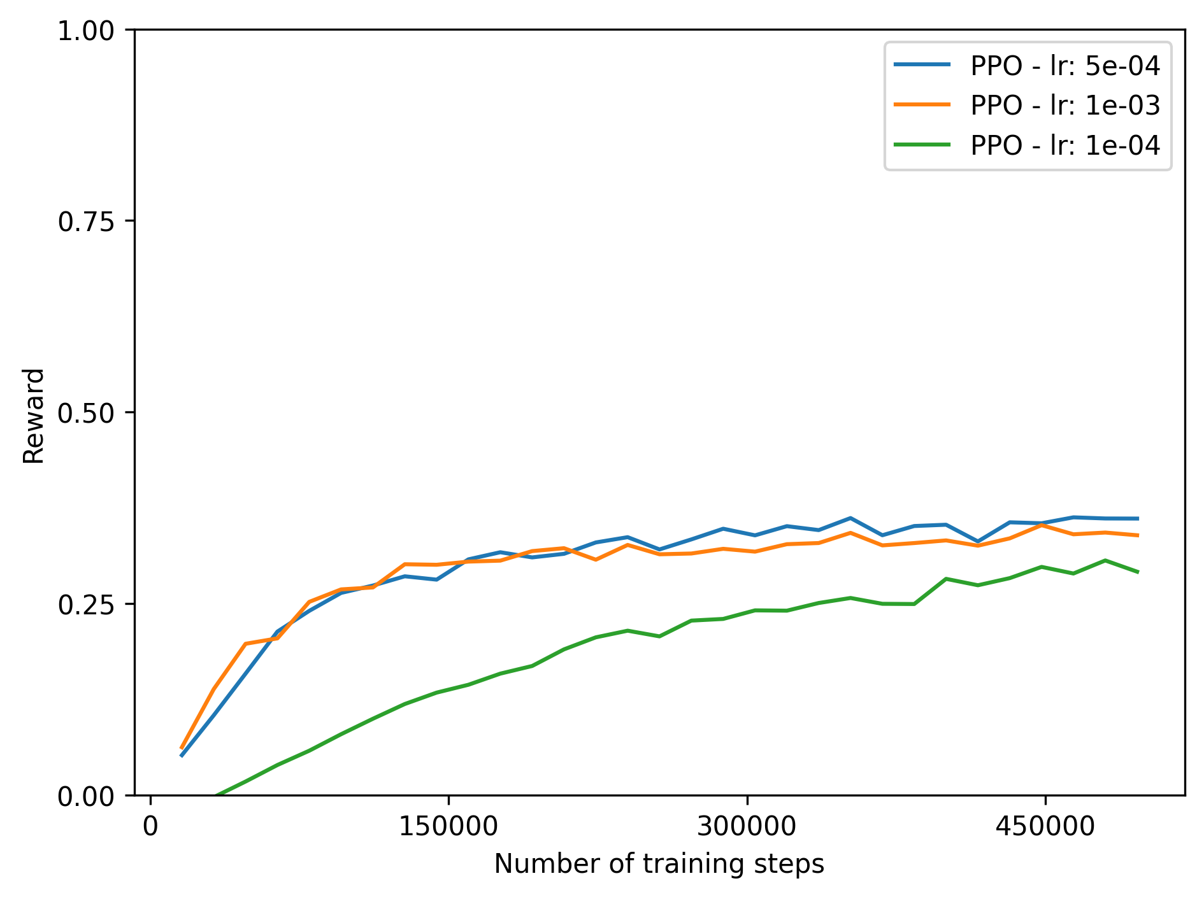
Baseline performance
Random model cumulative reward: -0.11
4x4 grid
6x6 grid
10x10 grid

Slide 7
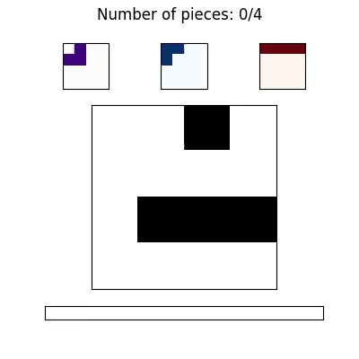
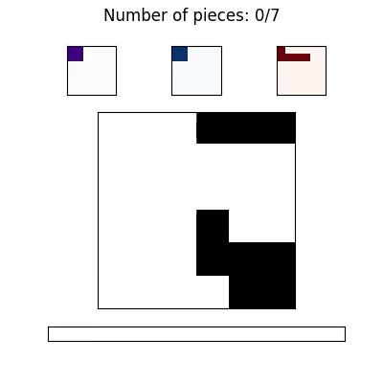
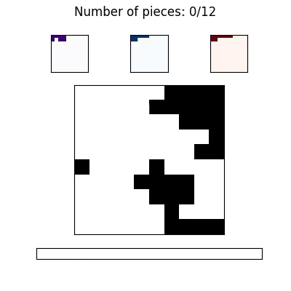

Slide 8
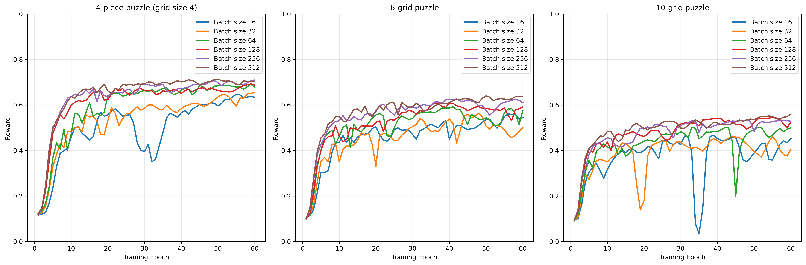
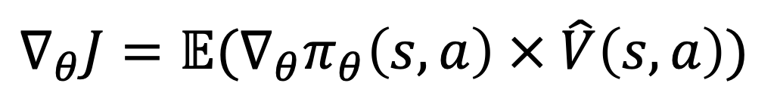
$$∇_{θ}J=𝔼(∇_{θ}π_{θ}\left(s,a\right) × \hat{V}\left(s,a\right))$$

Slide 9
Packing puzzle problem
With reinforcement learning
Martin van der Schelling and Alex Xiaole Jiang

